Slide 1
Front End Development
Task-2

Slide 2

Front End Development
Using HTML & CSS we have developed a front end web page based on education purpose. In full-stack development, front-end development is typically focused on creating the visual and interactive elements of the application that users interact with.
LMS Username | Name | Batch
2115a920 | GOKULA KRISHNAN A | A9
2115a921 | GOKULNATH K | A9
2115a941 | RAMVILAS H | A9
2115a930 | KARTHIKEYAN B | A9

Slide 3
INTRODUCTION
In full-stack development, front-end development is typically focused on creating the visual and interactive elements of the application that users interact with. Web client-server architecture is responsible for handling user interactions and displaying data.

Slide 4
HTML -
HTML is used to create the structure of web pages; and Bootstrap is a popular CSS framework that provides predefined styles and layout options. JavaScript frameworks provide additional functionality and tools for building complex, interactive user interfaces. They are useful to create responsive, interactive, and efficient user interfaces.
Web client server architecture
HTML Structure Tags – Forms field
Bootstrap – React.Js
jQuery- ajax - Promises
API integration

Slide 5

FRONT END DEVELOPMNENT
Developing a user interface webpage by using front end development.
Using HTML & CSS
For example we have developed a learing platform for web development ,etc….called CODETOWN by using “HTML &CSS.

Slide 6
CODETOWN
In this example, the page consists of a header, navigation menu, main content, and footer. The CSS styles are added in the head section of the HTML document.
The header contains the page title, and the navigation menu has links to different sections of the page. The main content contains three sections: About Us, Our Services, and Contact Us. The Contact Us section has a form for users to fill out and submit. The footer contains copyright information.

Slide 7
Algorithm :
Open a text editor like Notepad or Sublime Text on your computer.
Create a new file and save it with the extension ".html". For example, "index.html".
Add the basic HTML structure to the file
In the <title> tag, add a title for your web page. This will appear in the browser tab.
In the <body> tag, add the elements that you want to display on your web page. For example, you can add headings, paragraphs, images, links, forms, and tables.
To add a heading, use the <h1> to <h6>
To add a paragraph, use the <p> tag.
To add an image, use the <img>
To add a link, use the <a> tag.
To add a form, use the <form> tag
To add a table, use the <table> tag with the <tr>, <th>, and <td> tags.
Save the file and open it in a web browser to see how it looks.

Slide 8
SOURCED CODE:
<!DOCTYPE html>
<html>
<head>
<title>Codetown</title>
<style>
body {
font-family: Arial, sans-serif;
font-size: 16px;
}
header {
background-color: red;
padding: 20px;
text-decoration:overline;
}

Slide 9
nav a {
color:yellow;
text-decoration:bold;
}
main {
padding: 20px;
display: flex;
flex-wrap: wrap;
}
section {
background-color:pink;
flex-basis: 33%;
padding: 10px;
}

Slide 10
nav {
background-color:#333;
color:#fff;
padding: 10px;
}
nav ul {
margin: 4;
padding: 0;
list-style:disc;
display: flex;
}
nav li {
margin: 0 10px;
}

Slide 11
h2 {
margin-top: 0;
}
h3{
background-color:black;
color:gold;
padding:60px;
font-size:60px;
font-weights:bold;
}
ul {
list-style: square;
padding: 0;
margin: 0;
}

Slide 12
form {
display: flex;
flex-direction: column;
max-width: 400px;
}
label {
margin-bottom: 10px;
}
input[type="text"],
input[type="email"],
textarea {
padding: 10px;
margin-bottom: 10px;
border: 1px solid #ccc;
border-radius: 4px;
}

Slide 13
input[type="submit"] {
background-color: "pink";
color:"blue";
padding: 10px 20px;
border:solid;
border-radius: 4px;
cursor: pointer;
}
input[type="submit"]:hover {
background-color: "purple";
}
</style>
</head>

Slide 14
<body background="C:\Users\Windows\Downloads\lo.jpg">
<img src="C:\Users\Windows\Downloads\ct.jpg">
<header>
<h1>#CODETOWN</h1>
</header>
<h3>Welcome to #Codetown</h3>
<nav>
<ul>
<li><a href="intro.txt">Home</a></li>
<li><a href="about.txt">About</a></li>
<li><a href="cont.txt">Contact</a></li>
</ul>
</nav>

Slide 15
<main>
<section>
<h2>About Us</h2>
<p>At codetown Web Development, we're passionate about building beautiful, functional websites that help businesses succeed online.</p>
<a href="lm.txt">Learn More</a>
</section>
<section>
<h2>Our Services</h2>
<ul>
<li>Web Design</li>
<li>Web Development</li>
<li>SEO</li>
</ul>
</section>

Slide 16
<section>
<h2>Contact Us</h2>
<form>
<label for="name">Name:</label>
<input type="text" id="name" name="name"><br><br>
<label for="email">Email:</label>
<input type="email" id="email" name="email"><br><br>
<label for="message">Message:</label>
<textarea id="message" name="message"></textarea><br><br>
<input type="submit" value="Submit">
</form>
</section>
</main>
<footer>
<p>Copyright &copy; 2023-#codetown.All Rights Reserved.<br></br>
Designed & Developed by #codetown.</p>
</footer>
</body>
</html>

Slide 17
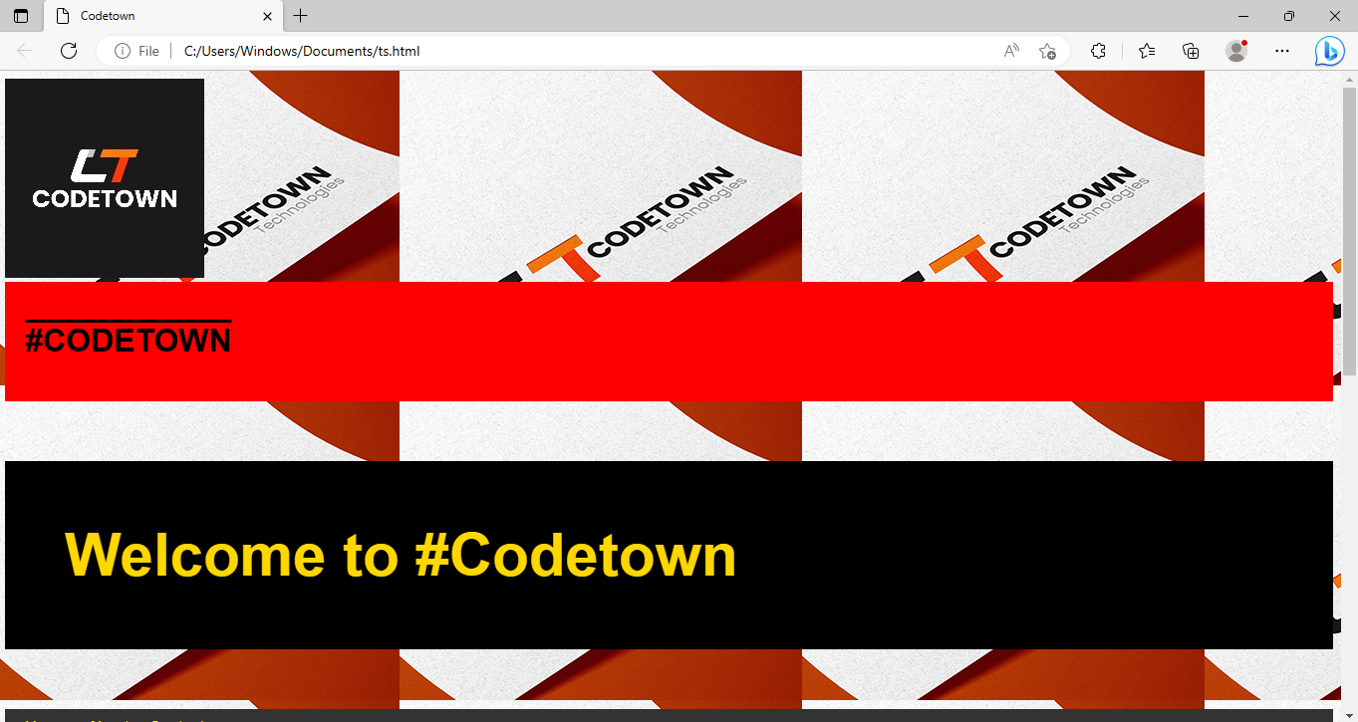

Slide 18
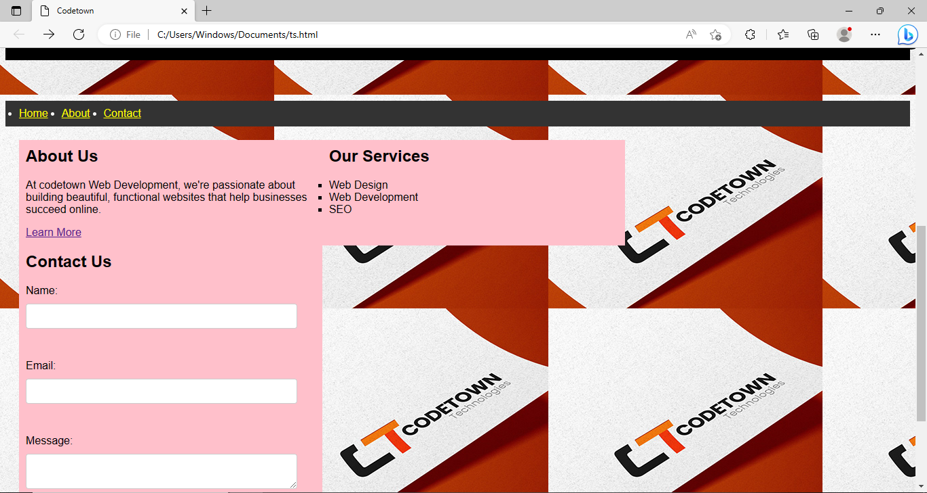

Slide 19
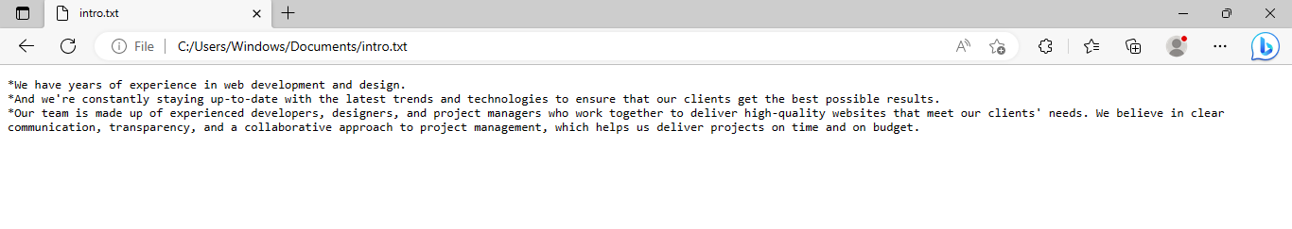
HOME-

Slide 20
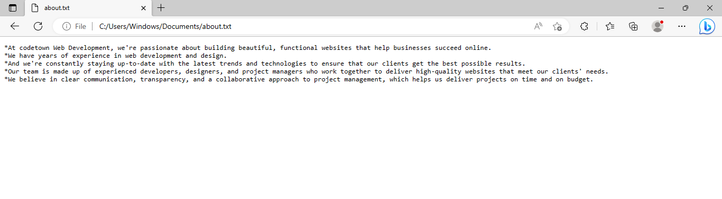
ABOUT-

Slide 21
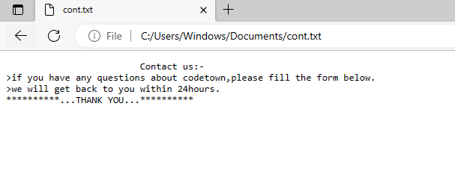
CONTACT-

Slide 22
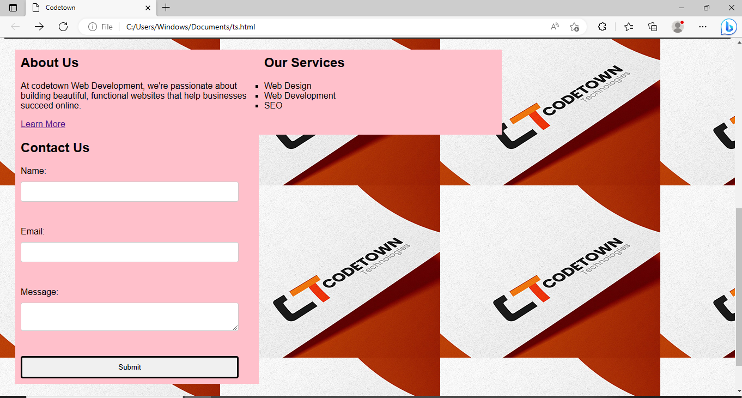

Slide 23
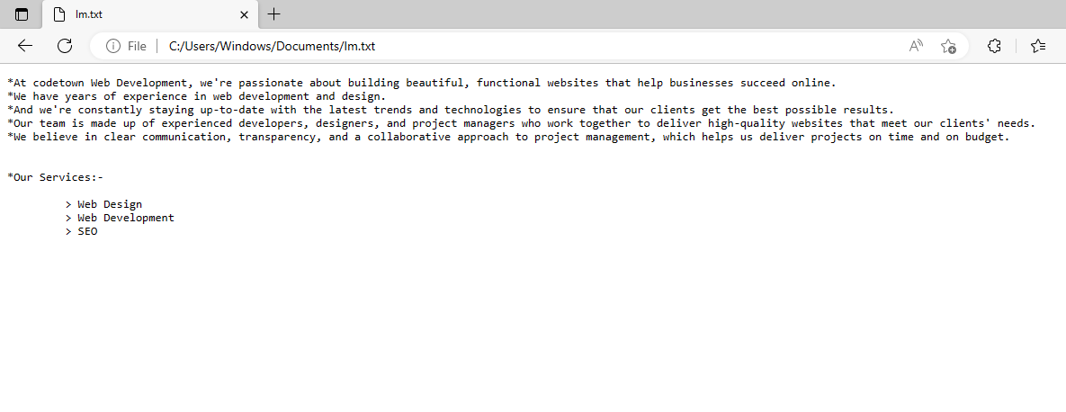
LEARN MORE-

Slide 24
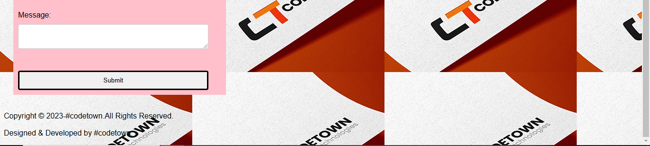
FOOTER-

Slide 25
In conclusion, front-end development is a critical aspect of web development that involves designing and developing the visual and interactive components of a website. It requires knowledge of HTML, CSS, and JavaScript, as well as an understanding of user experience (UX) and user interface (UI) design principles.
The front-end developer is responsible for creating an engaging user experience by designing and implementing the layout, typography, color schemes, and graphics of a website. They also ensure that the website is responsive and accessible across multiple devices and platforms.

Slide 26
Front-end development is a constantly evolving field, with new technologies and frameworks emerging regularly. Therefore, it is crucial for front-end developers to keep up with the latest trends and developments in the industry to create modern and functional websites that meet the needs of users and businesses alike.

Slide 27
In summary, front-end development plays a crucial role in creating visually appealing and engaging websites that attract and retain users. With the right skills and knowledge, front-end developers can create effective user interfaces that provide an exceptional user experience, thereby contributing to the success of a website and its business.

Slide 28
Submission Github
Insert Your Github Link Here

